Slide 1


Resonator Development for Studying Protein Single Crystals of Limited Dimensions at X-band
Jason W. Sidabras
D. Suter, E.J. Reijerse, A. Savitsky, W. Lubitz

Slide 2
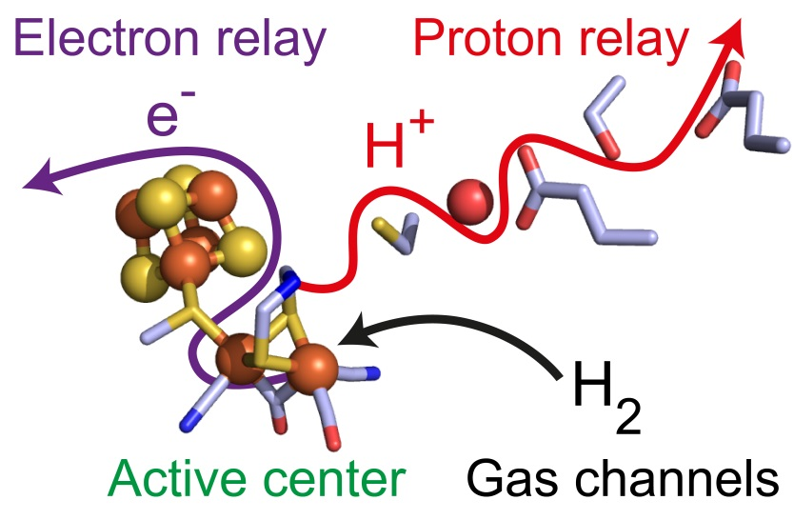
Motivation
Extremely Sample Limited
Nano-liter volumes at X-band
Materials Research
Samples of Limited Availability
Systems on a Chip/Micro-fluidics
Protein Single Crystals
Hydrogenase
2H⁺ + 2e⁻ ⇌ H₂
Understanding the mechanism of biological hydrogen conversion

Slide 3
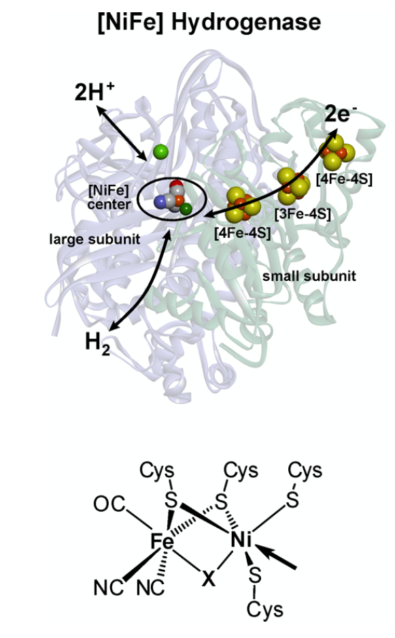
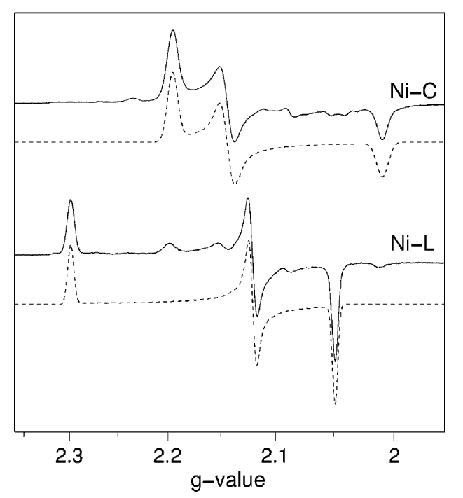
Why Single Protein Crystals?
EPR with Single Crystals:
Hydrogenase catalytic cycle has various redox states and several are paramagnetic
Disentangle angular dependencies of g- and A-tensors
Give insights into molecular interactions at the active site by relating to the X-ray Crystal Structure
Quantum Chemical Calculations to understand catalytic mechanism the full g-tensors axis. EPR data helps develop the calculations
Active Site
50-1000 nanoliter
Lubitz, Ogata, Rüdiger, Reijerse, Chem. Rev., 114, 2014
Foerster, Stein, Brecht, Ogata, Higuchi, Lubitz, JACS, 125, 2003
Notes:
----- Meeting Notes (9/8/16 15:12) -----
Talk less about it. Just that its been done before. Move to the front.
Orientation dependence.
----- Meeting Notes (3/30/17 16:58) -----
Protein single crystal
disentagle
full tensor information, best for even testing DFT
Quantum Chemical Calcuations not DFT

Slide 4
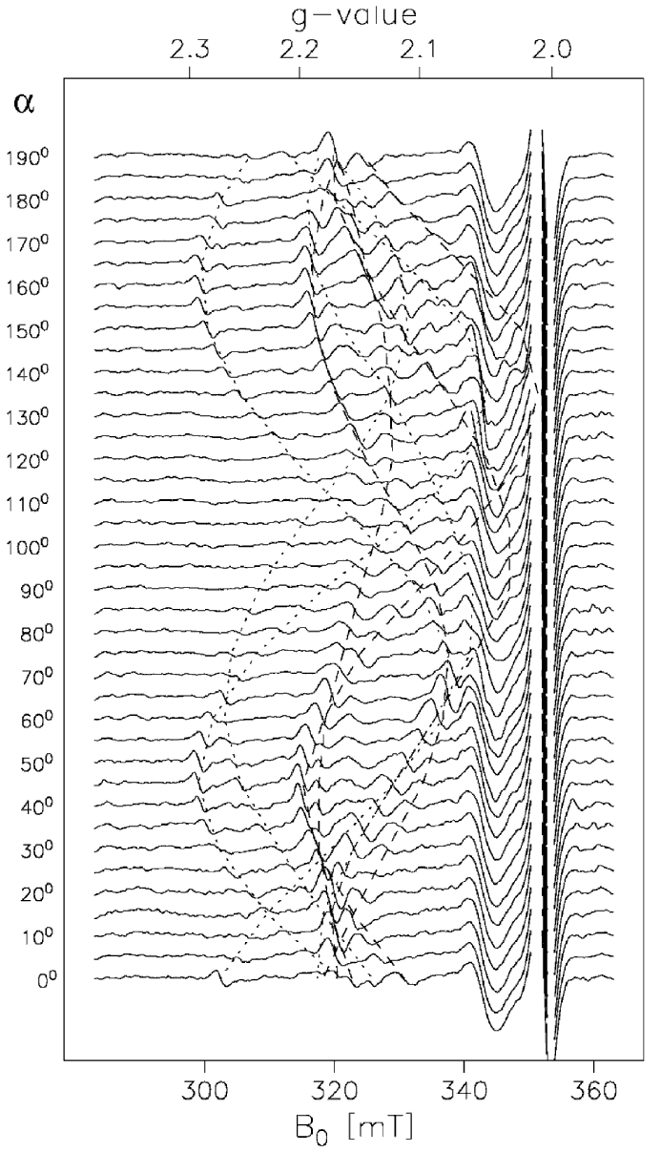
Why Single Protein Crystals?
EPR with Single Crystals:
Hydrogenase catalytic cycle has various redox states and several are paramagnetic
Disentangle angular dependencies of g- and A-tensors
Give insights into molecular interactions at the active site by relating to the X-ray Crystal Structure
Quantum Chemical Calculations to understand catalytic mechanism the full g-tensors axis. EPR data helps develop the calculations
Active Site
50-1000 nanoliter
Lubitz, Ogata, Rüdiger, Reijerse, Chem. Rev., 114, 2014
Foerster, Stein, Brecht, Ogata, Higuchi, Lubitz, JACS, 125, 2003
Notes:
----- Meeting Notes (9/8/16 15:12) -----
Talk less about it. Just that its been done before. Move to the front.
Orientation dependence.
----- Meeting Notes (3/30/17 16:58) -----
Protein single crystal
disentagle
full tensor information, best for even testing DFT
Quantum Chemical Calcuations not DFT

Slide 5
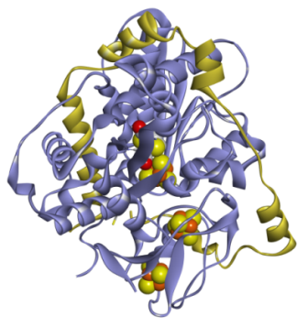
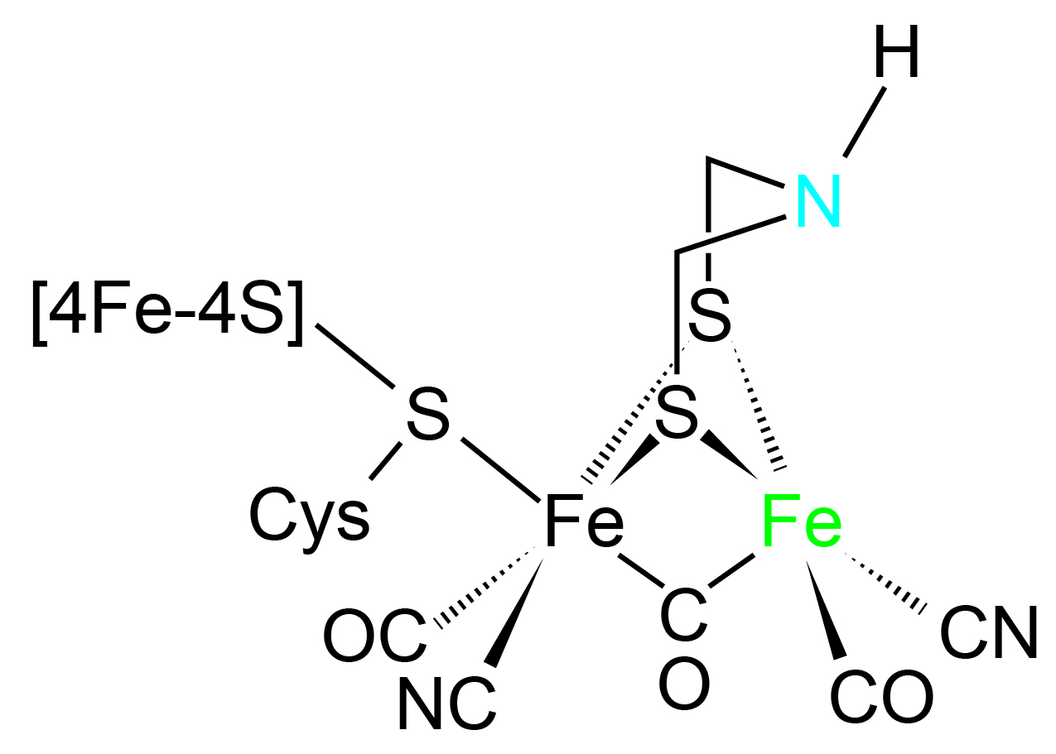
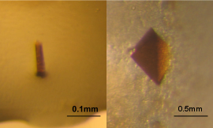
Single Protein Crystal [FeFe] Hydrogenase
To date no single crystal studies have been performed on [FeFe] Hydrogenase
Using FTIR, EPR, NMR, Raman, and NRVS a convincing catalytic cycle has been hypothesized.
However, it is very difficult to hypothesize the F-clusters and g-tensors axis, protein single crystals are needed.
D. desulfuricans HydAB
0.5-50 nanoliter
Lubitz, Ogata, Rüdiger, Reijerse, Hydrogenases, Chem. Rev., 114, 2014
Notes:
----- Meeting Notes (3/30/17 16:58) -----
7-10 A

Slide 6
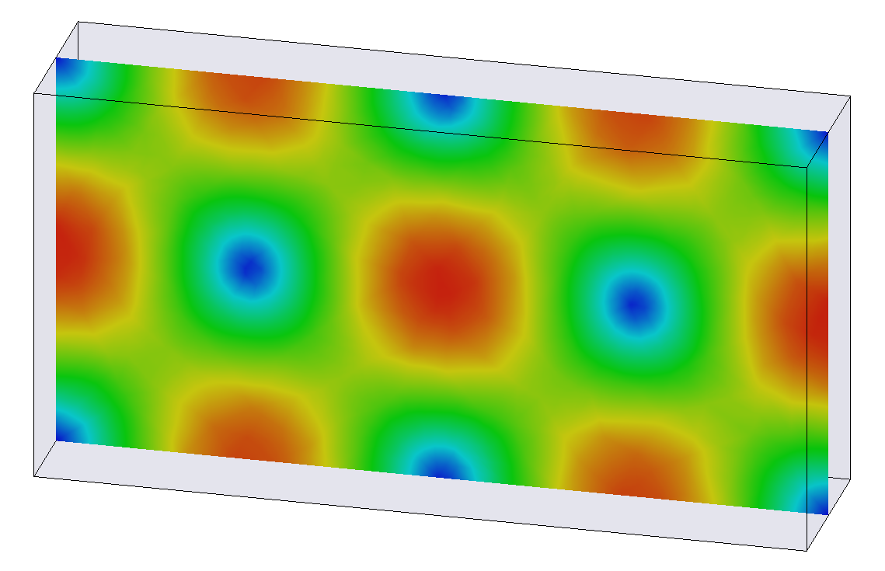
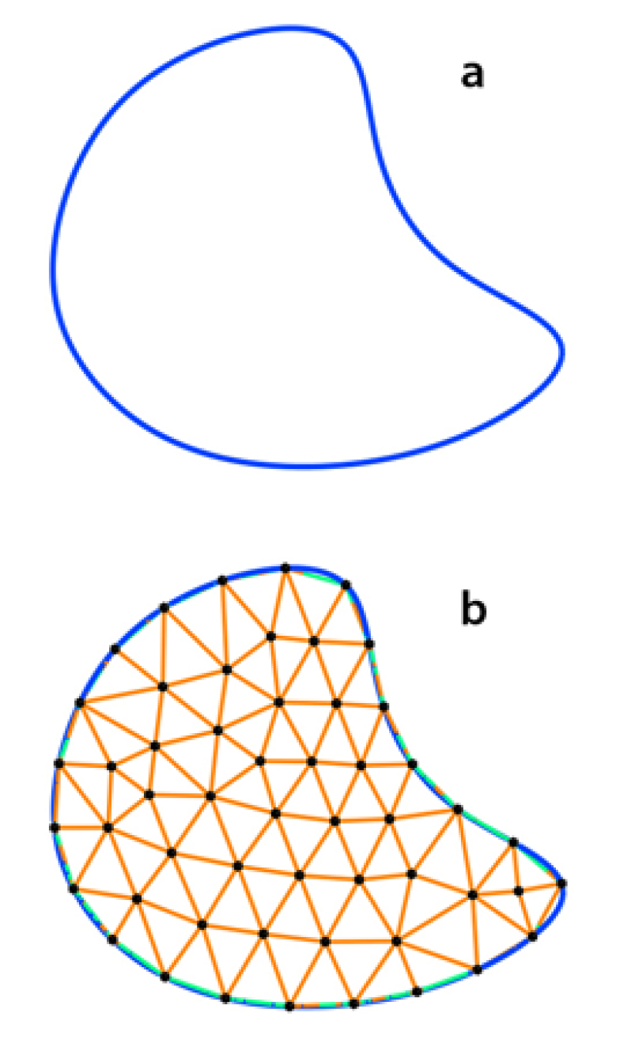
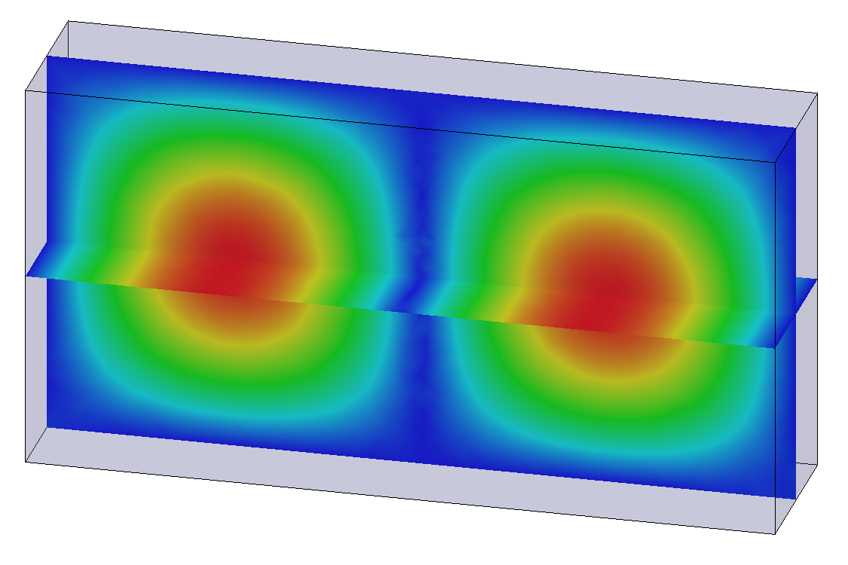
Resonator Introduction
Rectangular TE₁₀₂
Finite-Element Modeling
Ansys HFSS solves the full-wave Maxwell’s Equations for a given geometry and boundary condition
Build and Test on the Bench
Characterize the resonators and compare to simulation
Measure coupling, frequency, and Q-value
Experiments with Standard Samples
Further characterize the resonators using EPR
Sample handling (very important)
Magnetic field magnitude
Electric field magnitude
Notes:
----- Meeting Notes (3/30/17 16:58) -----
title methods

Slide 7
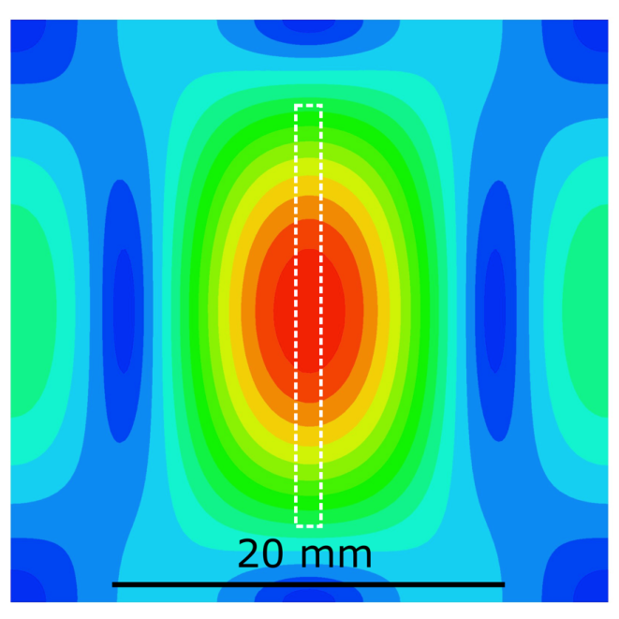
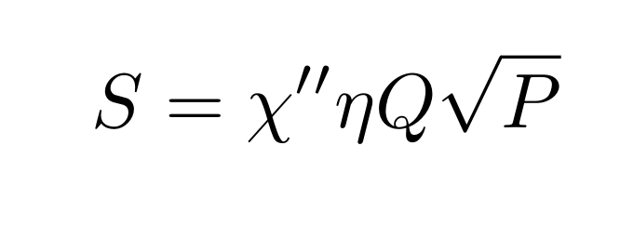
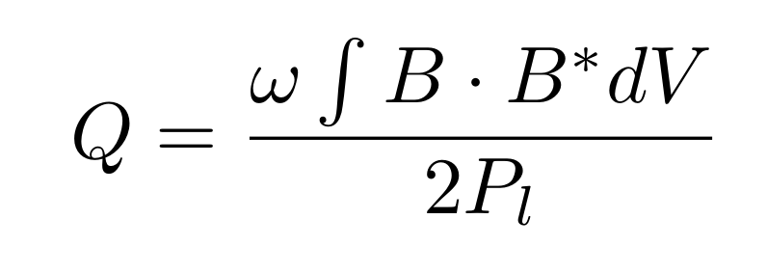
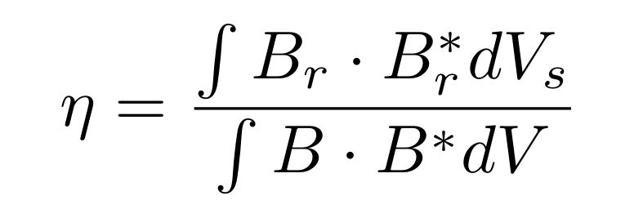
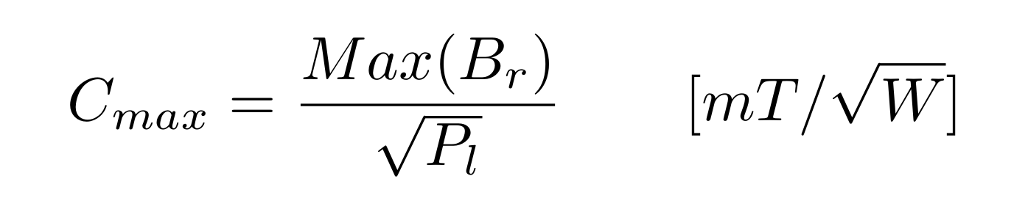
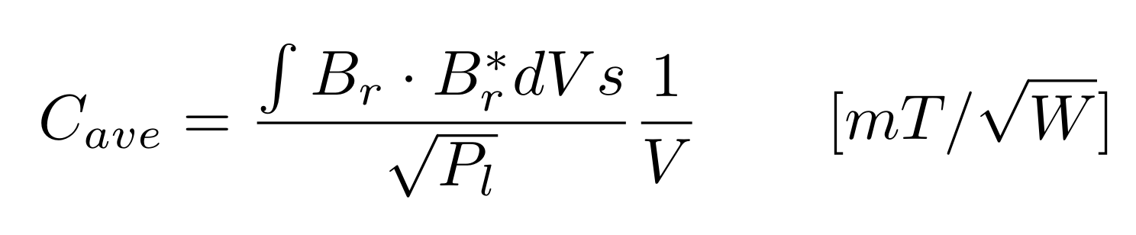
Resonator Characteristics
Based on a critically coupled resonator and reflection bridge configuration
Cylindrical TE₀₁₁
Signal:
Filling Factor
Q-value
Conversion Factor
Feher, Sensitivity Considerations in Microwave Paramagnetic Resonance Absorption Techniques, 36(2). 449,1957
Hyde, Froncisz, Advanced EPR: Applications in Biology and Biochemistry, Elsevier, 1989, Ch. 7: Loop-gap resonators, 277
Notes:
----- Meeting Notes (9/8/16 15:18) -----
finite-element modeling gives me these solutions
----- Meeting Notes (3/30/17 16:58) -----
mention TE011
square root sign
cavity resonators

Slide 8
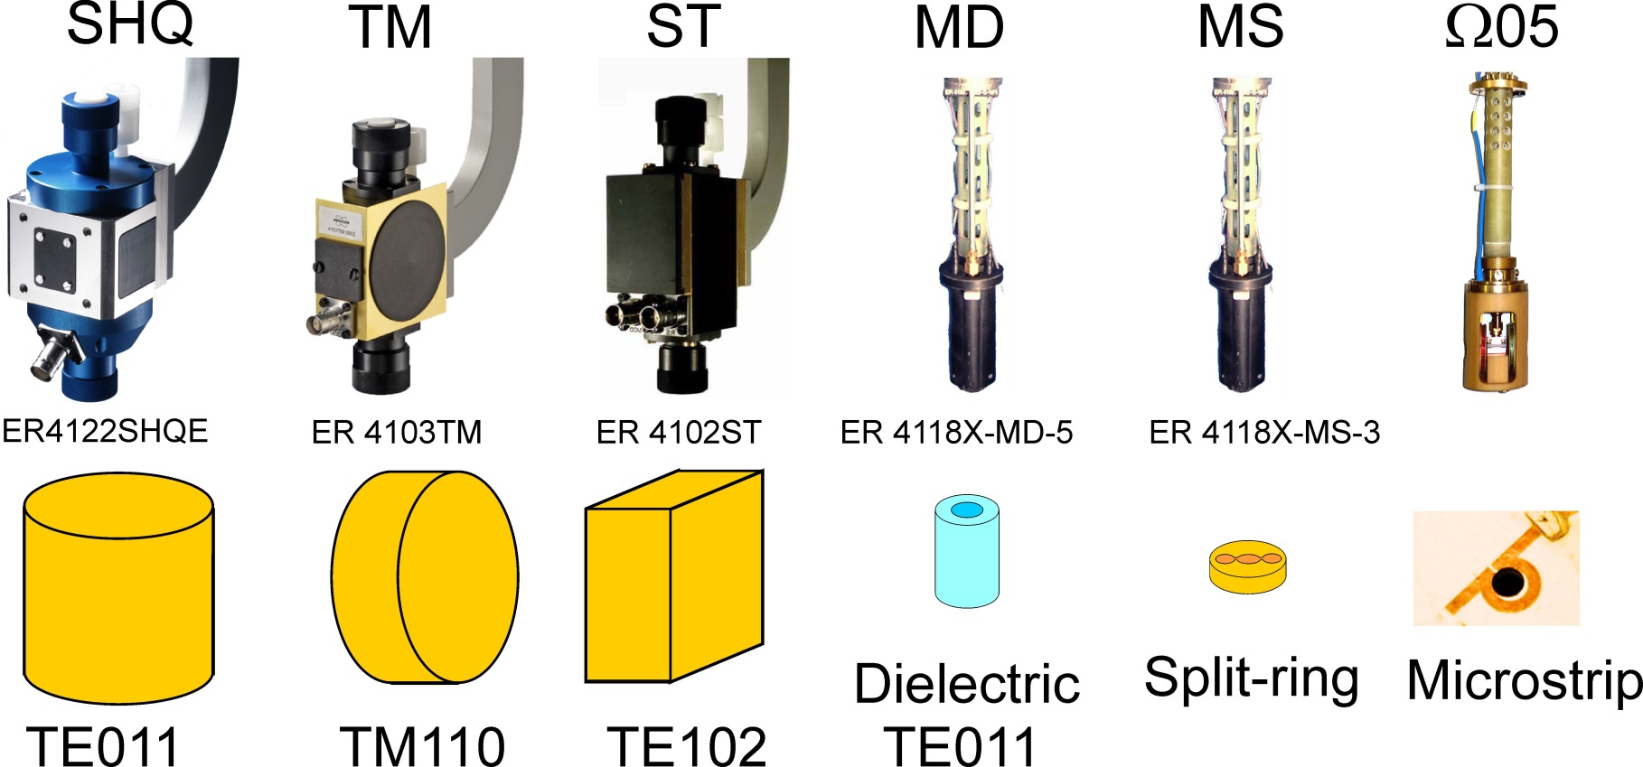
Increasing Sensitivity for Limited Samples

Slide 9
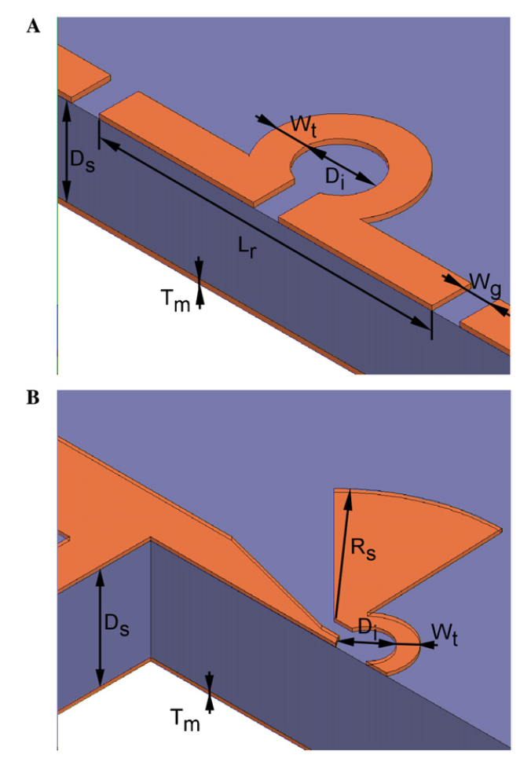
Planar Micro-Resonators for EPR
Tiny (< 500 μm) loop
Distributed capacitance
approx. λ/2 length
High dielectric substrate
Very High Conversion Factor
Q-value < 100 for Rogers material
Q-value approx. 200 for sapphire substrate
Narkowicz, Suter, Stonies, Planar microresonators for EPR experiments, J. Magn. Reson., 175, 2005

Slide 10
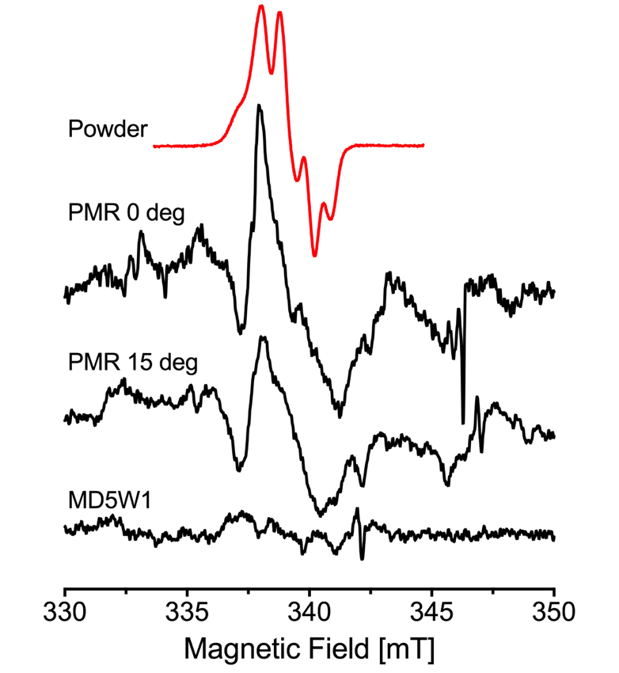
Planar Micro-Resonators Results
Experimental Results:
Tyrosine (Y_{D}*) Radical in Photosystem II
Single Crystal 0.3 x 0.3 x 0.5 mm³
0.6 x 10¹² spins/G
All simulations are performed with a 0.3 x 0.3 x 0.3 mm³ sample at room temperature
Simulation | MD5 DR ε=10 | 0.5 mm PMR
Freq. [GHz] | 9.67 | 9.58
Q₀-value | 15000 | 186
Norm. Su | 1 | 2.09
C_{max} [mT/W^{1/2}] | 0.65 | 3.7
C_{ave} [mT/W^{1/2}] | 0.65 | 2.2
Notes:
----- Meeting Notes (3/30/17 16:58) -----
measurements doing on a crystal
0.3 x 0.3 x 0.5

Slide 11
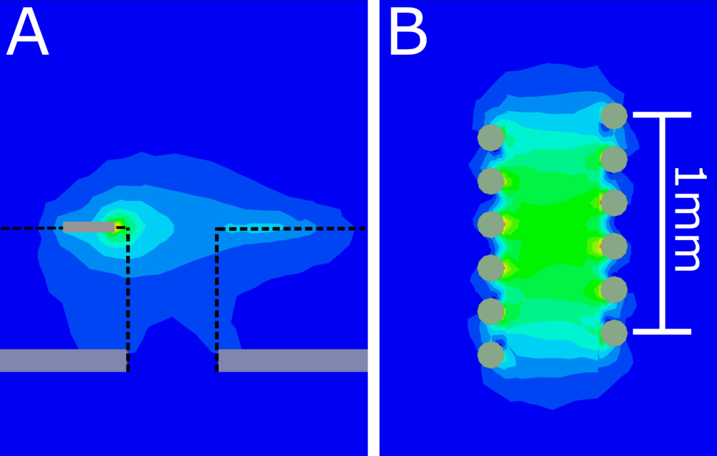
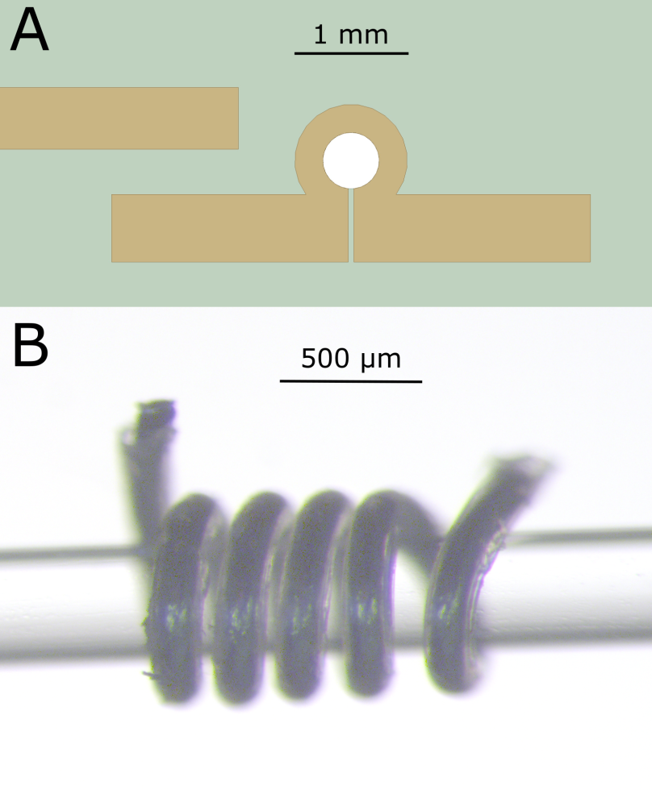
Micro Helix at X-band
Higher concentration of B₁
Higher Q-value (surface vs. volume)
More homogeneous field
Easier placement of small samples
1.2 mm Tall (0.15 mm wire)
5-6 windings 9.7 GHz

Slide 12
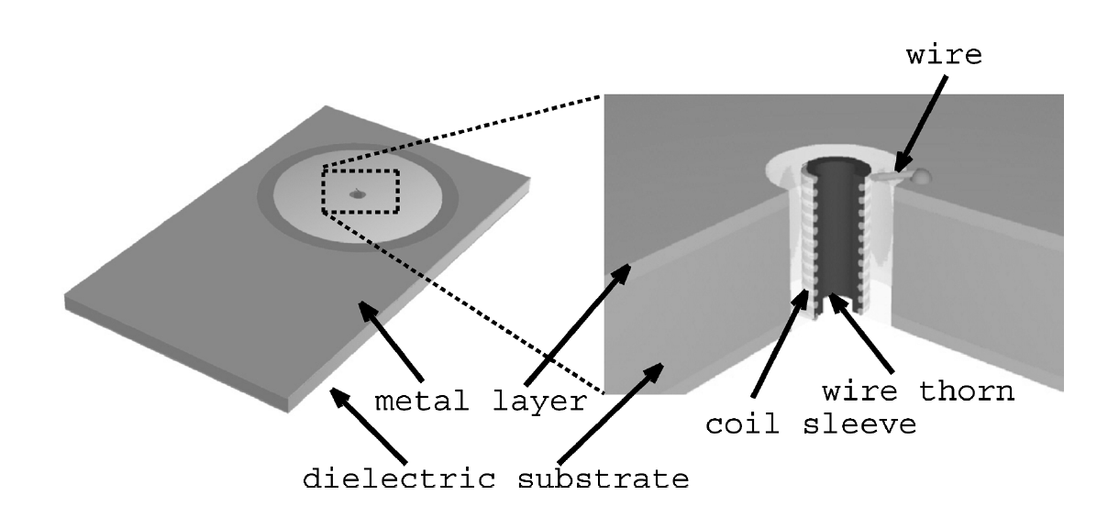
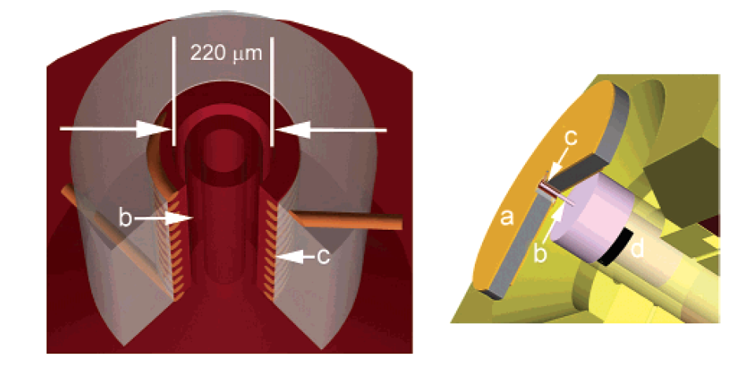
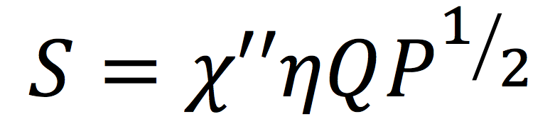
Micro-Coils in NMR
Size < 0.5 mm inner diameter
Parallel Plate Capacitance to resonate
Q-value < 30
Good Sensitivity enhancement
is realized for limited samples
K. Yamauchi, J.W.G. Janssen, A.P.M. Kentgens, Implementing solenoid microcoils for wide-line solid-state NMR, J. Magn. Reson. 167 (2004)
Hans Janssen, Andreas Brinkmann, Ernst R. H. van Eck, P. Jan M. van Bentum, Arno P. M. Kentgens, Microcoil High-Resolution Magic
Angle Spinning NMR Spectroscopy, JACS, 128, 2006
Notes:
----- Meeting Notes (9/8/16 15:29) -----
Very low Q.
900 MHz systems

Slide 13
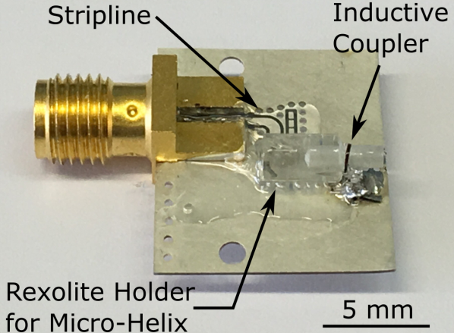
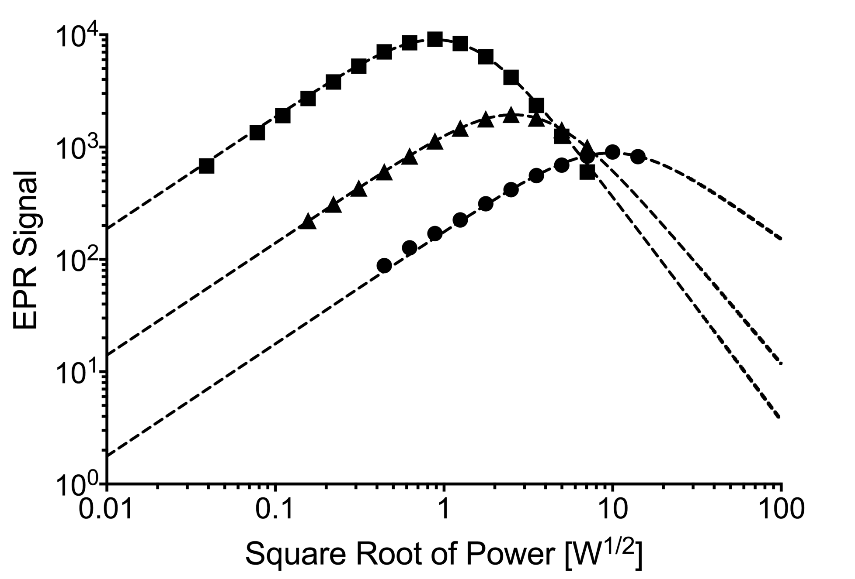
Micro-Helix Preliminary Results
Simulated
Simulation | MD5 DR ε=10 | PMR 0.5 mm | Helix 0.4 mm
Freq. [GHz] | 9.67 | 9.58 | 9.41
Q₀-value | 15000 | 186 | 360
Norm. Su | 1 | 2.09 | 9.5
C_{max} [mT/W^{1/2}] | 0.65 | 3.7 | 3.5
C_{ave} [mT/W^{1/2}] | 0.65 | 2.2 | 3.3
Measured
LiPC Crystal 0.3 x 0.2 x 0.2 mm³
MD5: 1
PMR: 2.2
Micro-Helix: 10.2
Notes:
Add slide numbers
----- Meeting Notes (9/8/16 15:29) -----
LiF SHow which is which
----- Meeting Notes (3/30/17 16:58) -----
micro helix advantages
scale on

Slide 14
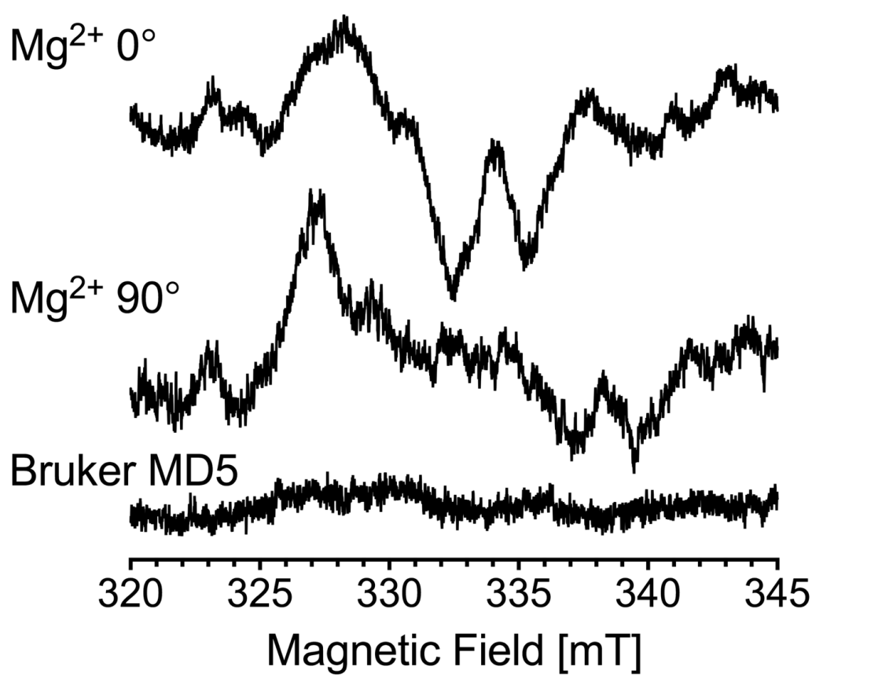
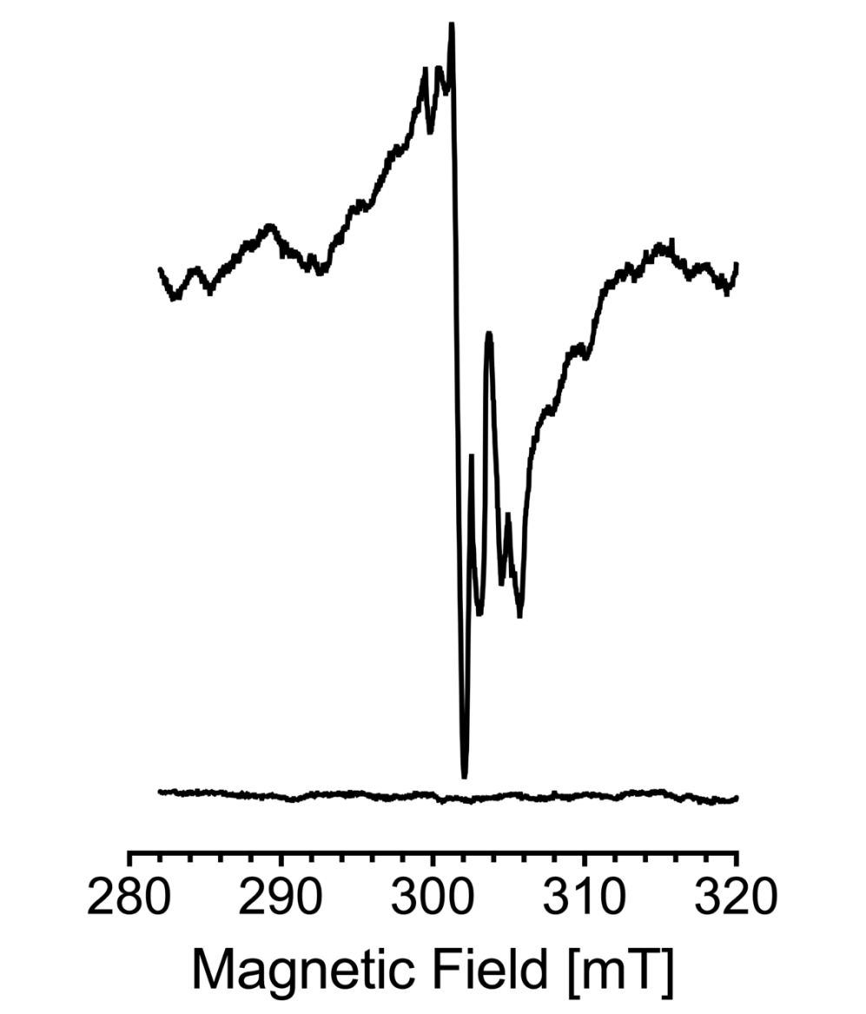
Micro-Helix Preliminary Results
Experimental Results:
Tyrosine (Y_{D}*) Radical in Photosystem II
Experiment performed at 120 K.
0.3 x 10¹² spins/G
Experimental Results:
Mn²⁺ signal
Single Crystal
0.3 x 0.3 x 0.25 mm³
Empty Resonator
Notes:
----- Meeting Notes (3/30/17 16:58) -----
measurements doing on a crystal
0.3 x 0.3 x 0.5

Slide 15
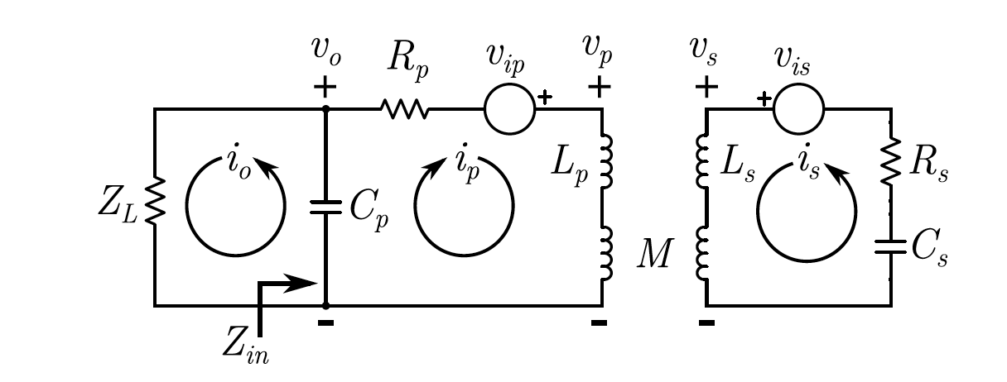
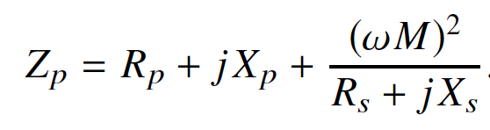
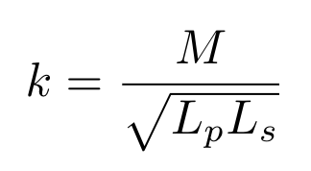
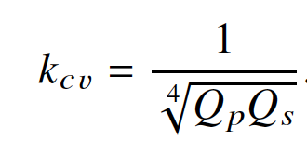
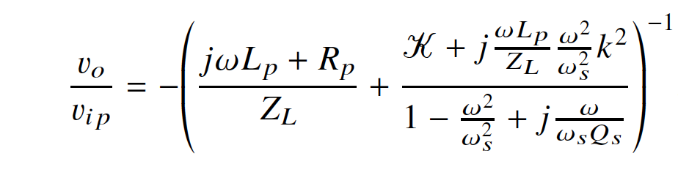
Coupling with Large Mutual Inductance
Coupling constant k is much larger than needed for maximum power transfer.
Instead the coupling constant is optimized for maximum impedance transfer.
The primary is then matched to the load for typical power transfer.
Output voltage is enhanced and noise is reduced.
Sidabras, Mett, Hyde, MRI surface-coil pair with strong inductive coupling, Rev. Sci. Instrum., 87, 124704, 2016

Slide 16
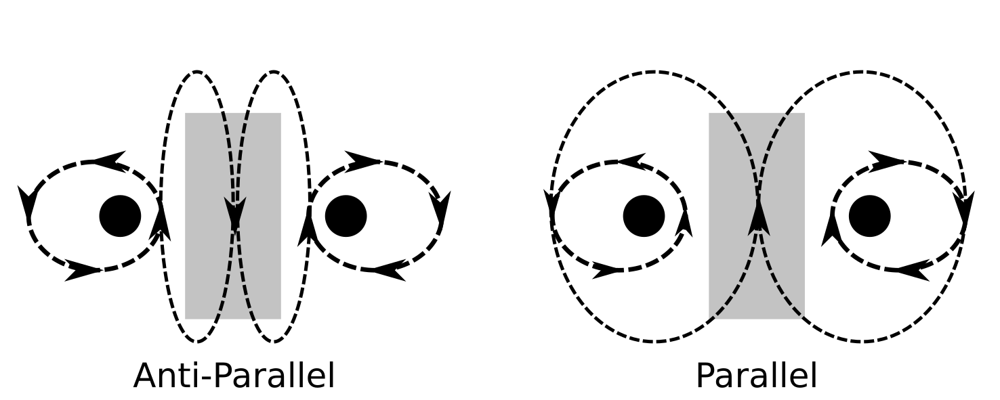
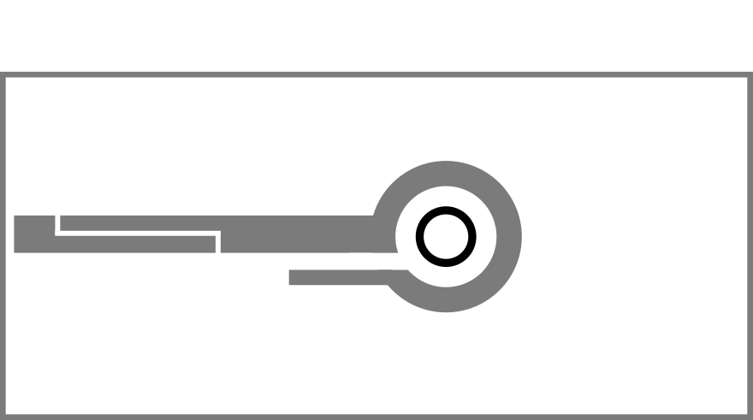
Coupling with Large Mutual Inductance
Current Coupling Scheme:
Grounded loop has a very high self-resonance (~30 GHz)
Currently coupling the anti-parallel mode
Significant capacitance lowers modes and mutual inductance
Parallel mode is measured at ~2 GHz
~1.7x coupling enhancement
(17x total over MD5)
New Coupling PC Board:
Loop Resonant at 17 GHz
Planar loop reduces E-field
Coupling implemented

Slide 17




Acknowledgements
Future Work
Sample handling, including a goniometer
Repeatable Micro-Helix fabrication and manufacturing techniques
Test Helix below 50 K
Prof. Dieter Suter
Dr. Nick Cox
Dr. Hideaki Ogata
Dr. Anton Savitsky
Dr. Edward Reijerse
Prof. Wolfgang Lubitz
Marie Skłodowska-Curie Individual Fellowship
http://act-epr.org

Slide 19
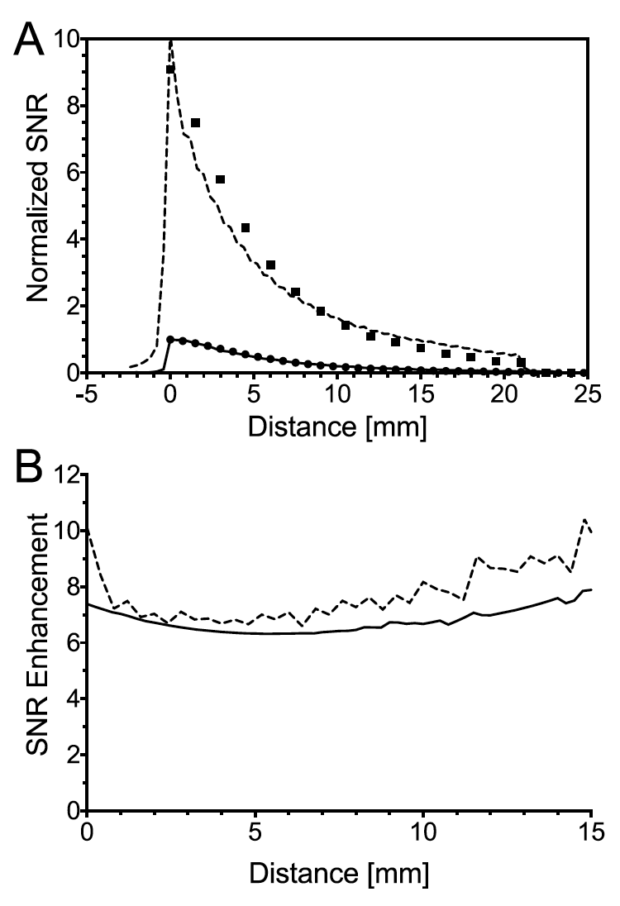
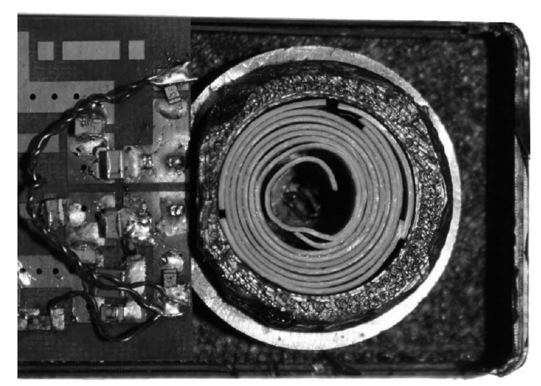
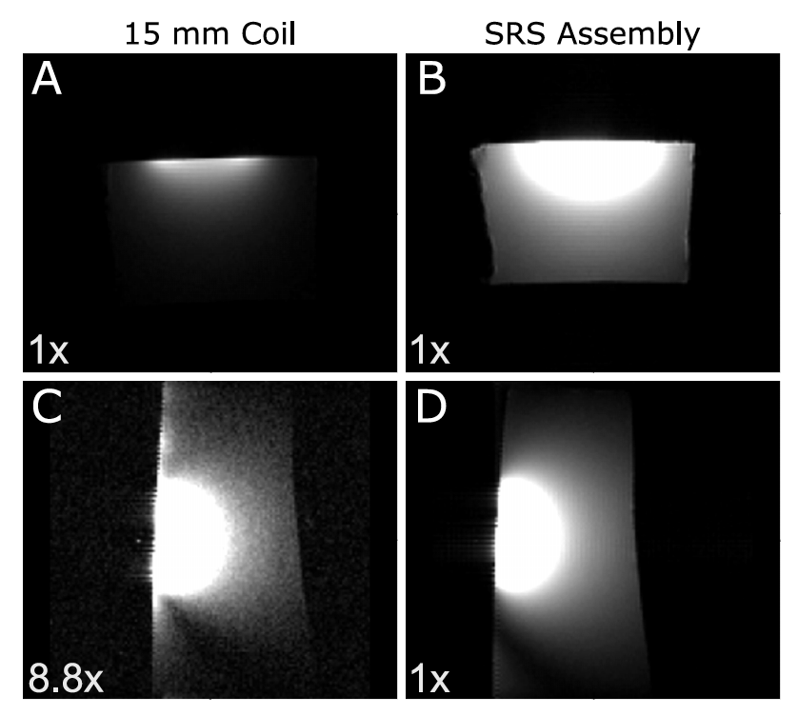
Coupling with Large Mutual Inductance At 400 MHz
Theoretical Enhancement of 3 (spiral) * 3 (coupling)
13 mm
Sidabras, Mett, Hyde, MRI surface-coil pair with strong inductive coupling, Rev. Sci. Instrum., 87, 124704, 2016

